Slide 1



E -COMMERCE SALES ANALYSIS DASHBOARD
www.reallygreatsite.com
𝒷𝓎 𝑅𝒶𝓀𝓈𝒽𝒾𝓉𝒽𝒶

Slide 2
PROJECT OBJECTIVE
Analyze sales and profit trends.
Evaluate regional and product performance.
Study customer behavior and payment preferences.
Examine operational factors like discounts and shipping time.
Build an interactive Excel dashboard.
Generate insights to support business decision-making.

Slide 3
ATTRIBUTES USED IN DATASET
ID
ORDER ID
ORDER-DATE
ORDER-MONTH
CUSTOMER ID
REGION
COUNTRY
CITY
PRODUCT CATEGORY
PRODUCT NAME
SALES
QUATITY
DISCOUNT
PROFIT
CHANNEL
PAYMENT METHOD
SHIPPING DAYS
YEAR
MONTH

Slide 4
KPI’s DESIGNED
TOTAL SALES
TOTAL PROFIT
TOTAL QUANTITY
TOTAL NUMBER OF ORDERS
PROFIT MARGIN
YOY GROWTH

Slide 5


In 2024 the total profit is: 184.58k
in 2025 the total profit is: 160.42k
184.58K − 160.42K = 24.16K
Percentage Change:
(24.16/184.58)×100≈13.1%
Profit dropped by about 13% in 2025 compared to 2024.
What are the total profit’s in region in 2024 and 2025?

Slide 6

How is business performing year over year (YoY)?
Business performance declined year-over-year, with sales decreasing by 15.74% in 2025 compared to 2024.

Slide 7
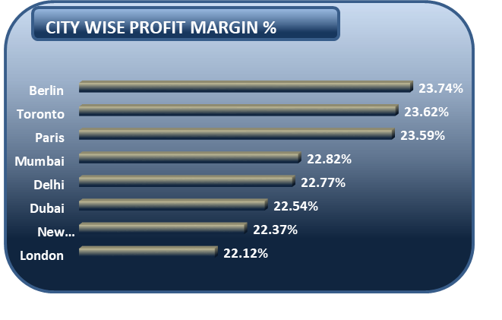
Which city has the highest profit of margin?
City A leads overall profitability, while City B emerged as the top performer in 2025, indicating shifting regional performance trends.
Profit reduced, indicating an opportunity to improve margin efficiency.

Slide 8
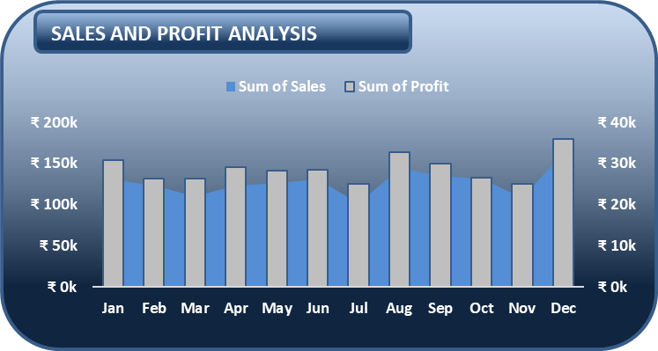
Which months show peak and low performance?
Business performance peaks toward the end of the year, with December recording the highest sales and profit, while March and September show the lowest performance, indicating seasonal fluctuations in demand.

Slide 9

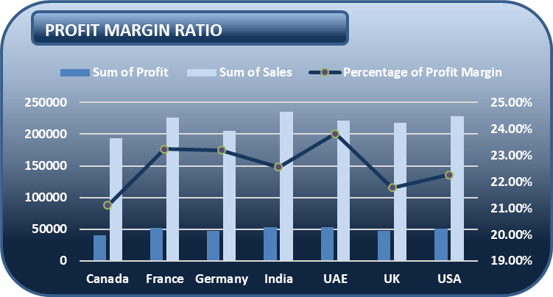
Which countries show peak and low performance?
INDIA, FRANCE, UAE
These countries act as primary revenue drivers and represent the company’s strongest markets.”
Canada contributes a smaller share of overall revenue, suggesting an opportunity to strengthen market penetration

Slide 10
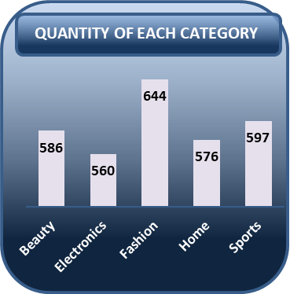
Which product category contributes most to sales?
The FASHION product category contributes the highest share of total sales, indicating strong customer demand and market preference for this category

Slide 11
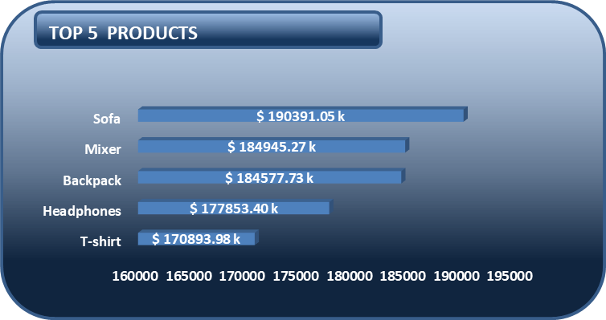
What are the Top 5 products by sales?
The top 5 Products are: SOFA, MIXER, BACKPACK,
HEAD-PHONES, T_SHIRT
Ensure stock availability, increase promotion efforts, and use successful products to boost sales of other items.

Slide 12
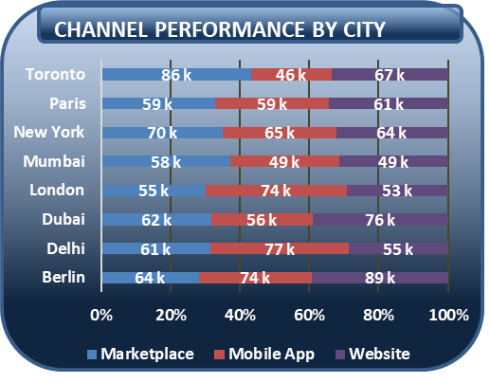
Do certain cities prefer certain channels?
Customer purchasing channels vary by region,
showing region-specific buying preferences.
Apply region-based channel marketing strategies to
maximize engagement and sales.

Slide 13
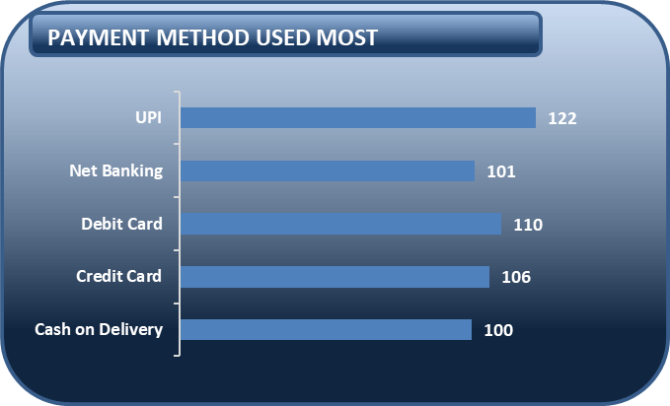
Which payment method is most used?
UPI and Debit Card are the most frequently used payment methods across countries, indicating strong adoption of digital payments among customers.

Slide 14
PAYMENT METHOD USED IN EACH REGION
Are digital payments dominating over COD?
Customers strongly prefer digital payment methods such as UPI, debit cards, and credit cards over Cash on Delivery, indicating increasing adoption of cashless transactions.

Slide 15
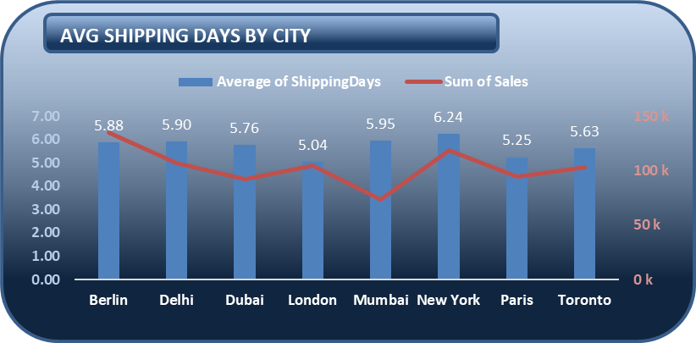
Does shipping time
affect sales?
Sales performance does not show a strong direct relationship with shipping time, as several cities with longer delivery durations still achieve high sales.
factors such as market demand, product popularity, or customer base may influence sales more than delivery speed.

Slide 16
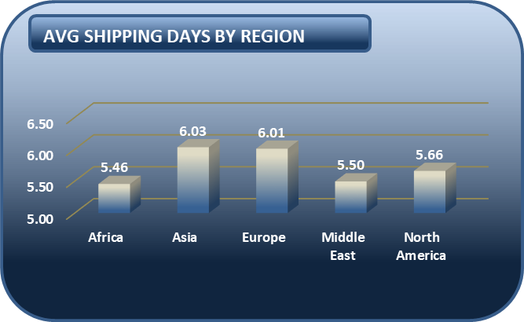
Which regions have longer delivery times?
Asia and Europe shows the longest average delivery time compared to other regions, indicating slower logistics performance in that market.

Slide 17
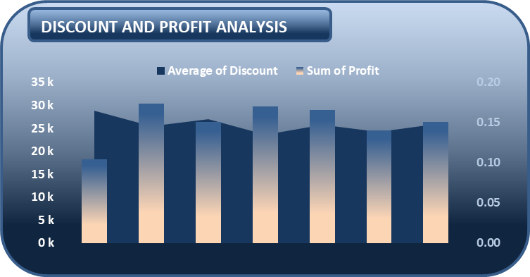
How do discounts impact profit?
Higher discounts do not consistently lead to higher profits.
Excessive discounting appears to reduce profitability,
while moderate discount levels maintain healthier profit performance.

Slide 18
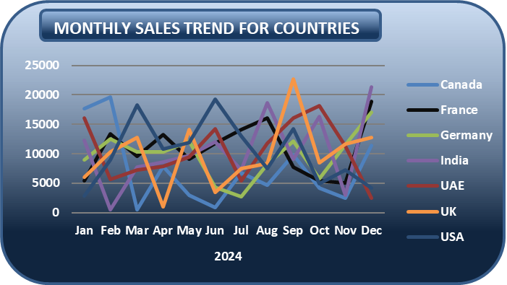
Which country shows the most consistent sales trend?
France demonstrates the most stable monthly sales performance,
indicating predictable demand and
steady customer purchasing behavior.

Slide 19
Where should we expand marketing investment?
Marketing investment should be expanded in India and the UK, as they show high sales but fluctuating demand.
Consistent marketing can help stabilize sales by
maintaining continuous customer engagement.

Slide 20
Thank
You

